Slide 1
The CAREC Think Tank Network Virtual Dialogue Thinking through crises – The role of think tanks
The virtual dialogue on 24 March, 4-6 PM Beijing/Ulaanbaatar time

Slide 2
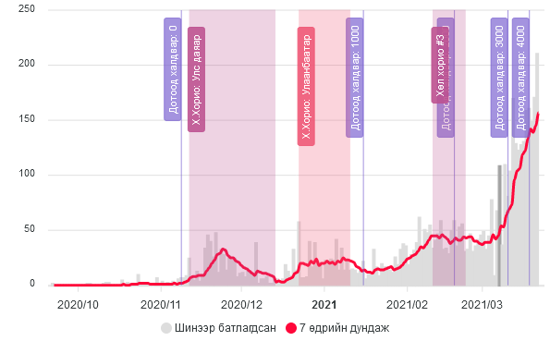
What are good examples and lessons learned on the role of think tanks for informed public policy responses during the COVID-19 pandemic?
The pandemic started spreading in 10th November 2020

Slide 3
Assessments of impact of Covid-19 on household (UNDP, Apr 2020 and World Bank, May, Sep, Dec 2020)) and business (UNDP, Apr 2020 and Chamber of Commerce, Dec 2020)
Decision making process in Mongolia goes through the State Emergency Commission
Deputy Prime Minister is the head of the Commission and ministers and high ranking ministry and agency officials are members
There is no full time research capacity for this commission
Highly reliant on Health ministry at early stages of the pandemic
Case in point: Our study on the impact of Covid 19 in April 2020 at the onset of the pandemic
The State Emergency Commission established a Research Working group in November 2020
National University of Mongolia simulation of Covid-19 spread in Mar 2021
In February 2021, a group of researchers from NUM presented the new Prime Minister with projection of the Covid 19 spread among the population
This promptly followed with a lockdown of 21 days during national holiday
However, impact assessment on the economy needs to be addressed. Especially with the implementation of “10 trillion Togrog program”
This shows the need for research capacity for the country. Updated projection on the spread of the pandemic and its impact on the economy needs to be carried out.
Case in point: Impact of Covid on economy assessment by the World bank and National Chamber of Commerce are latest updates
This shows a room for national think tanks assessing and projecting the impact of such events in the future

Slide 4
What strategies can the think tanks adopt to upgrade their capacity to develop and share cogent analysis and practical advice to decision-makers in a potential crisis situation with multi-dimensional challenges?

Slide 5
Capacity of a such think tank needs to be diverse and capable
Should be able to cover issues related to: Economy, public policy, health, sectoral developments, banking, SME, international trade, infrastructure development and its impact, impact of big projects, labor and demographic changes
Think tanks needs to be more specialized and can collaborate
The Government and International organizations can be the main contractor, create demand for domestic research
Analysis must be easy to understand, precise in policy recommendation and be implementable
However, think tanks must always be developing its research capacity (academic studies must be carried out)

Slide 6
How to strengthen the role of the think tanks in Central Asia, the Caucasus, China, and Mongolia or CAREC to promote and sustain economic and social progress amid and after the pandemic by leveraging multiple sources of channeling ideas, both through advocacy and public policy advice?

Slide 7
Cross country studies should be promoted, to share knowledge and learn from country experiences
Capacity building activities: Joint research with reputable think tanks from USA, UK, Japan, Korea etc
Demand creates supply: domestic research capacity is paramount

