Slide 1
the role of think tanks for public policy responses during the COVID-19 pandemic
Analysis of the development of the pandemic and of countermeasures (Infections, stringency of containment measures, timing)
Analysis of economic impact and government policy countermeasures (Macro - monetary and fiscal policy, support measures, - more specifically - MSMEs, Tourism, etc.)
Analysis of public opinion and social behavior (e.g. attitudes towards vaccination)
Analysis of options to build back better (digitalization, greening, gender-equality, health systems etc.; economic corridors)

Slide 2
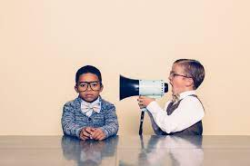
What strategies can think tanks adopt to share cogent analysis and practical advice to decision-makers?
Talk to them (in understandable language)
Talk to society to influence them
Talk to opinion leaders and media to influence society
How to strengthen the role of think tanks in CAREC to promote and sustain economic and social progress?
Joint publications (shall we set up a journal?)
Joint events (think-tank forum, research conference)
International organizations for collaboration (e.g. CEEMAN)
Joint outreach (joint statements and initiatives)

Slide 3
CAREC Institute eLearning Platform
https://elearning.carecinstitute.org/
Open for utilization by all key international, regional, and national partners.
Partners’ developed contents shall be related to CAREC priority areas.
Partners’ lead experts shall be responsible keeping the posted content timely and relevant.
Partners shall bear the responsibility for copyright, plagiarism, and accuracy of the content.
The language of video lectures and discussions shall be preferably English with subtitles in one of the languages commonly used in the CAREC region (i.e. Russian or Chinese).

