Slide 1

Thinking through crisis —— the role of think tanks: CCG experience
Dr. Ann Tang
Deputy Secretary General, CCG

Slide 2


CCG ranked 64th in the World’s Top 100 Think Tanks in the 2020 Global Go To Think Tank Index (GGTTI) Report released by the University of Pennsylvania on Jan 28, 2021, among one of the World’s Top 100 Think Tanks for four consecutive years.
CCG is granted Special Consultative Status at the United Nations Economic and Social Council (ECOSOC).
The only non-governmental think tank with the qualification for independent establishment of Post-doctoral research workstations issued by government.
A Member of the Belt and Road Think Tank Alliance
A Founding Member of the US Research Think Tank Alliance

Slide 3
CCG responded quickly to the pandemic and was the first to host webinars. After the COVID-19 broke out, CCG held its first webinar on March 19 in 2020, ahead of other think tanks in China.
CCG hosts the largest number of webinars. In 2020, CCG held over 40 webinars in the series “China and Globalization in the Time of Coronavirus”.
CCG hosts webinars that engage the most diverse groups of stakeholders from across the globe.
CCG host webinars that hit the most important pandemic issues facing governments around the world.
CCG host webinars that attract millions of viewers from the internet.

Slide 4
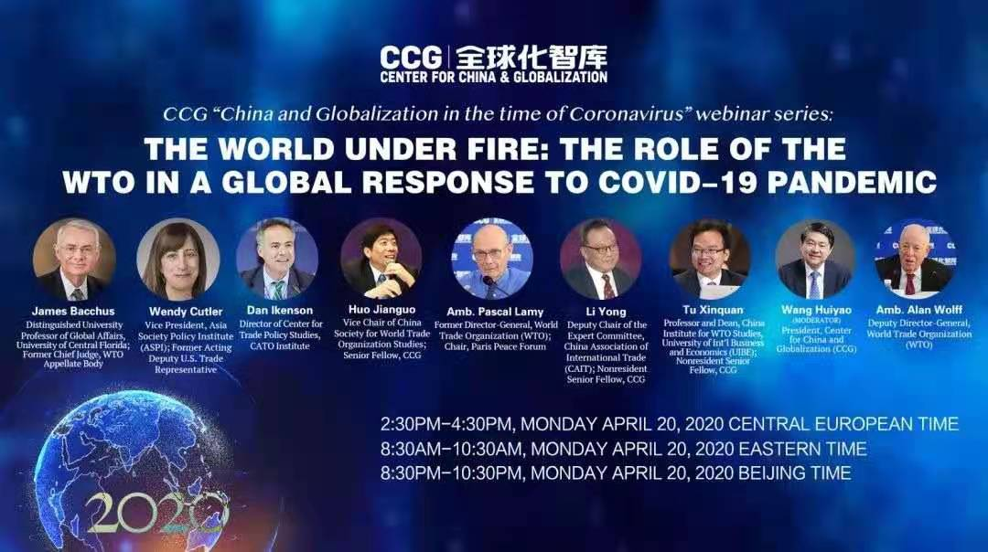
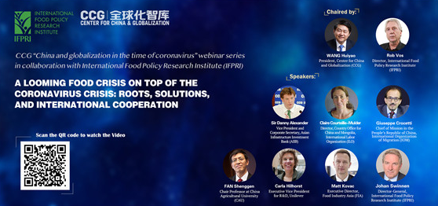
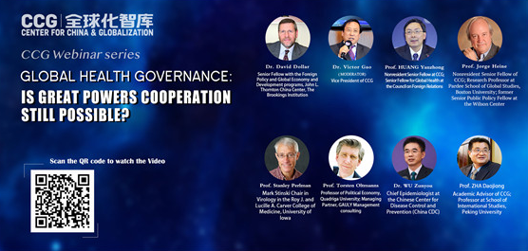
The World under fire: the role of the WTO in a global response to COVID-19 pandemic (April 20th)
A looming food crisis on top of the coronavirus crisis: roots, solutions, and international cooperation” (English) in collaboration with International Food Policy Research Institute (IFPRI) (May 18th)
Global Health Governance and International Cooperation: Is great powers cooperation still possible? (August 19th)

Slide 5
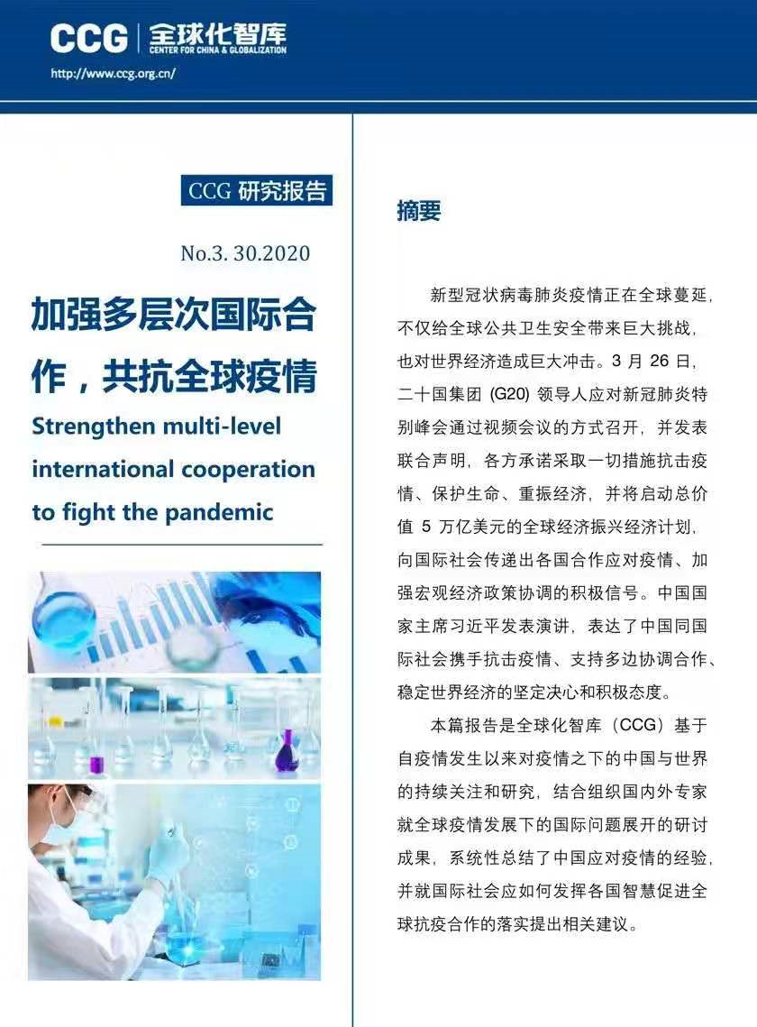
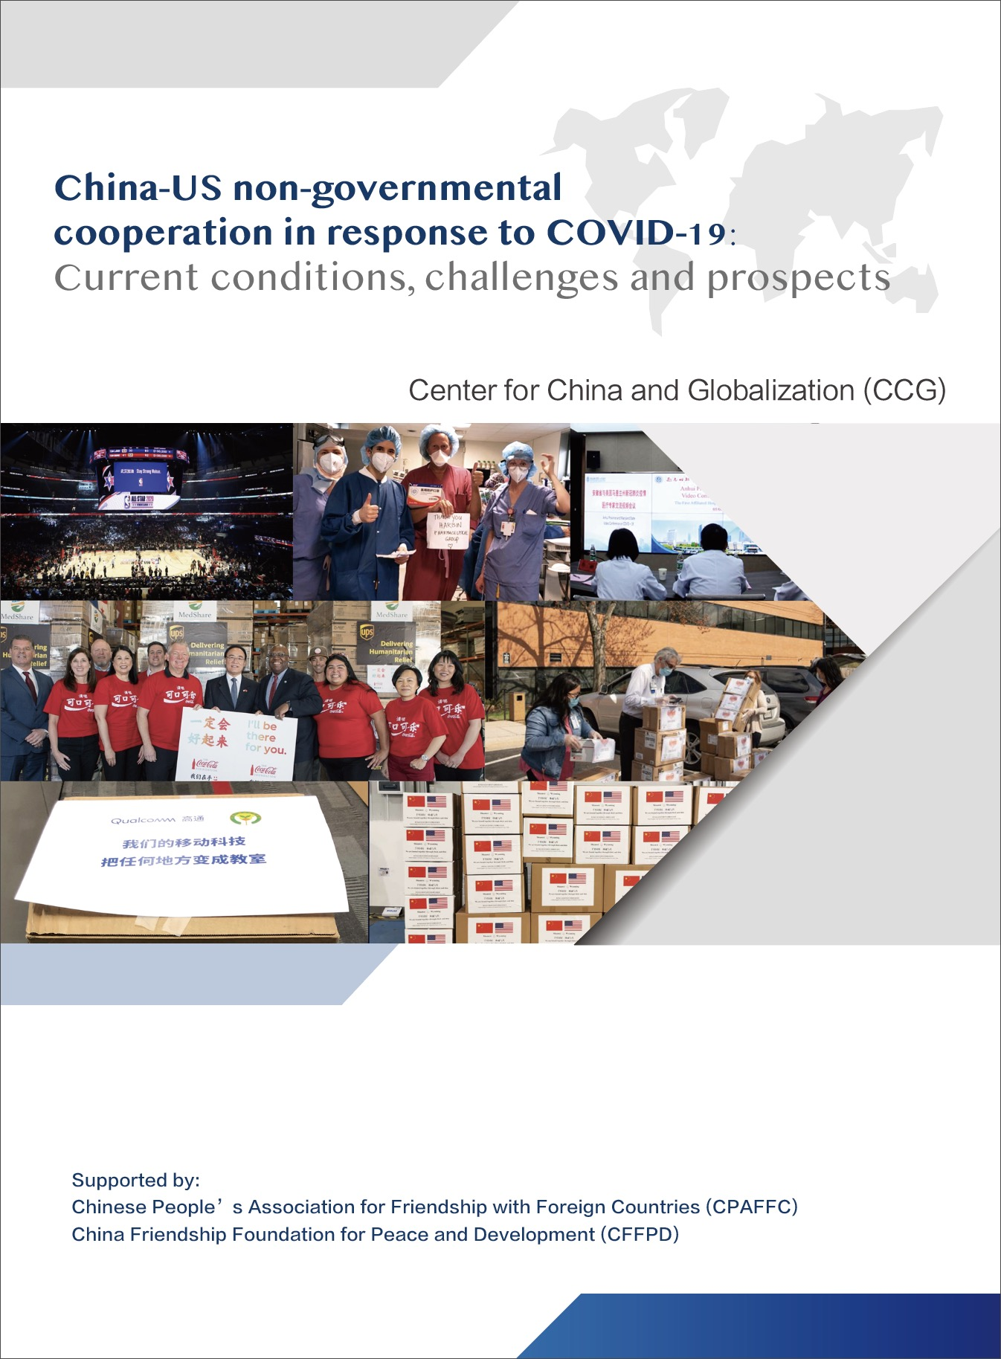
Strengthen multi-level international cooperation to fight the pandemic (April 5th), calls to strengthen multi-level int’l cooperation
China-US non-governmental cooperation in response to COVID-19: Current conditions, challenges and prospects (July 6th)

Slide 6
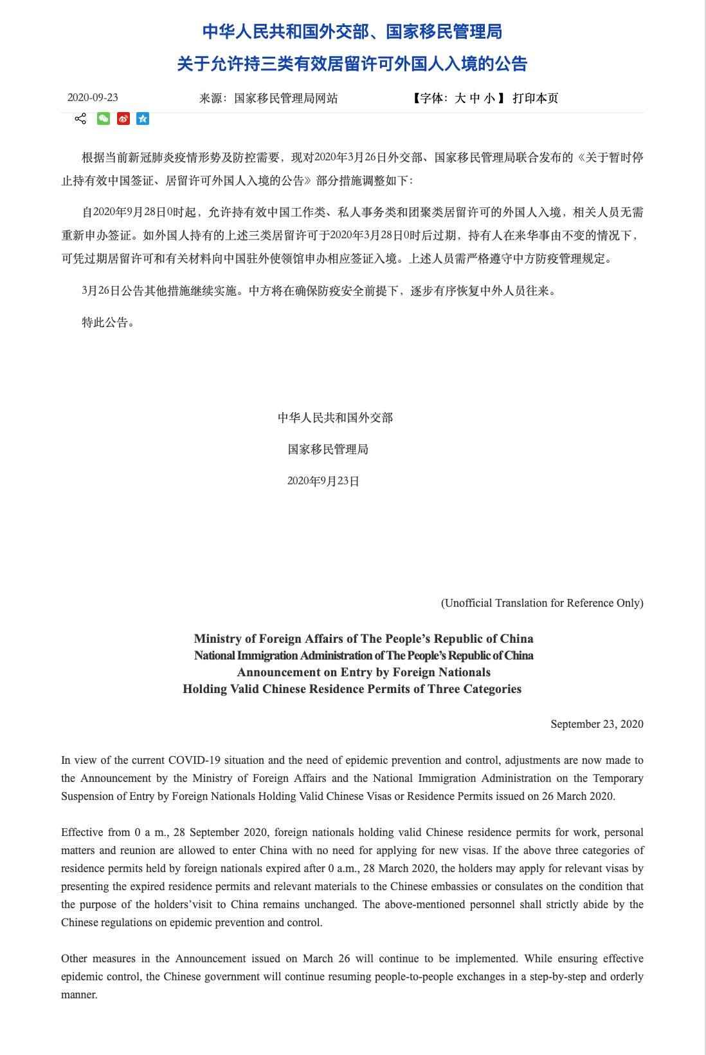
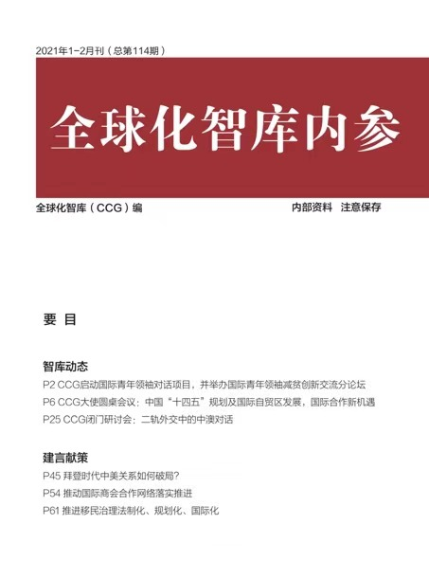
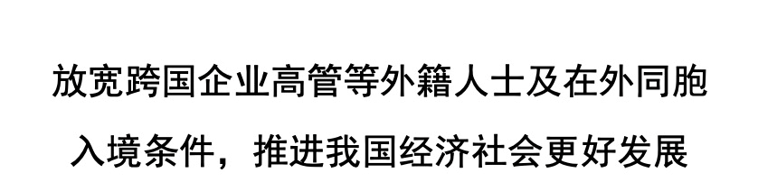
Announcement on Entry by Foreign Nationals
Holding Valid Chinese Residence Permits of Three Categories released by Ministry of Foreign Affairs of The People’s Republic of China
National Immigration Administration of The People’s Republic of China

