Slide 1

Access to water, sanitation in CAREC Region
Dr. Iskandar Abdullaev

Slide 2

Water, Sanitation in CAREC Region: introduction
Water and sanitation are key human rights
Water is a key ingredient of individual, household aтd economic development
Water and Sanitation are most concerned issues of development in CAREC region (even before COVID-19)
Efficient response policies to COVID-19 outbreak include adequate water supply and sanitation services

Slide 3
Water Security: Comparison with other regions
Source:ADB.2018

Slide 4
Water Security: Comparison with other regions
Source:ADB.2018

Slide 5

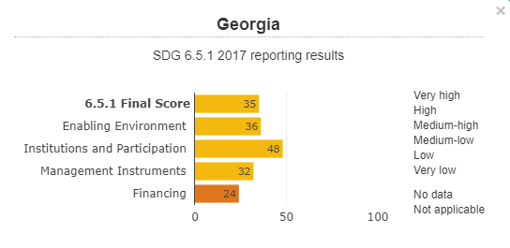
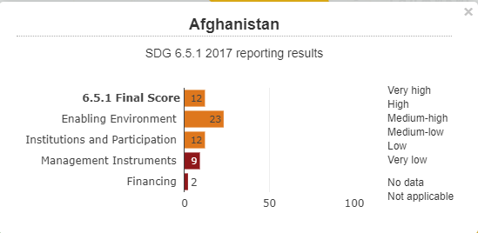
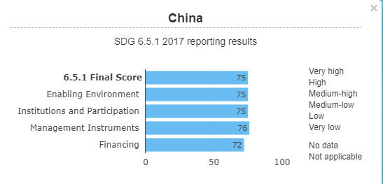
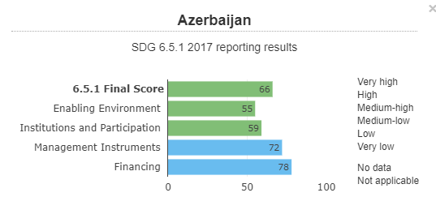
SDG 6 Implementation: CAREC region
Source: http://iwrmdataportal.unepdhi.org/global651data

Slide 6
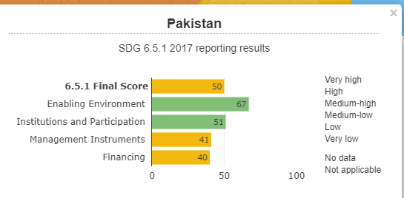
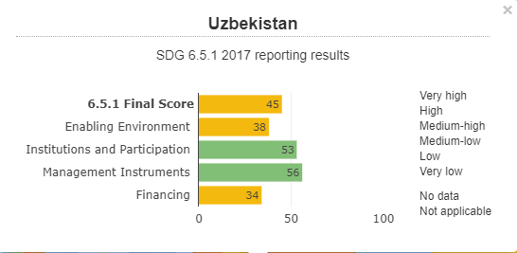
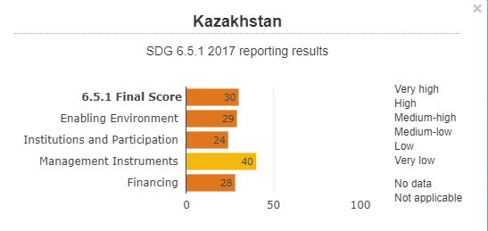
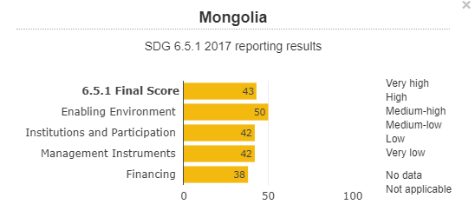
SDG 6 Implementation: CAREC region
Source: http://iwrmdataportal.unepdhi.org/global651data

Slide 7
Water, Sanitation in CAREC Region: Water Security and SDG 6
CAREC region’s water security (household) performance:
  Improvement required : 3 countries out of 11 are having very low water security
  Most of concerned areas are financing of the water sector, enabling environment
SDG 6.5.1: countries of CAREC region perform varyingly:
  China -75 and Afghanistan – 12
  Lowest indicator is Financing of water sector for most of CAREC countries

Slide 8
Water, Sanitation in CAREC Region: review
Source: World Bank Open Data

Slide 9
Water, Sanitation in CAREC Region: review
Source: World Bank Open Data

Slide 10
Water, Sanitation in CAREC Region: review
Access to drinking water in CAREC countries range from 50% up to 95%, at least 8 countries population having > 80% access to clean water
Sanitation services range from 40% to 80%, most of the population having 80-90% access to the sanitation
Last decade, CAREC countries achieved considerable progress on water and sanitation

Slide 11
Water, Sanitation in CAREC Region: review
Urban vs. rural gap: water supply and sanitation services differ greatly
Drinking water vs. sanitary services: National governments are having special drinking water programmes in every CAREC country, however sanitation improvement programmes are rare
Data quality: data/statistics on drinking water and sanitation is not well structured
Control on quality of services: quality of services are irregularly controlled/monitored

Slide 12
Water, Sanitation in CAREC Region: national efforts
CAREC countries have both national programs and international projects to support improvement of drinking water and sanitation services
Major areas for interventions are infrastructure (new and old), financing mechanisms and engaging of the users into operation and maintenance of drinking water and sanitation systems
Socioeconomic challenges- beyond infrastructure-centric solutions: financing, water users' role and climate adaptation are key areas to focus on

Slide 13
Water, Sanitation in CAREC Region: Policy Messages
New political and economic frameworks and continuation of water sector reforms – important
Governments must introduce incentives in the water sector for making water sector attractive for private and international investments.
Capacity building, education and research in the water sector are weak areas in CAREC countries: drastic reforms are required to improve both quality of education and research
Technology transfer and facilitation of private financing to water saving, water delivery and water distribution
National partners to prepare long-term infrastructure rehabilitation plans for water sector with clear prioritization

Slide 14
THANK YOU
www.carecinstitute.org

