Slide 1
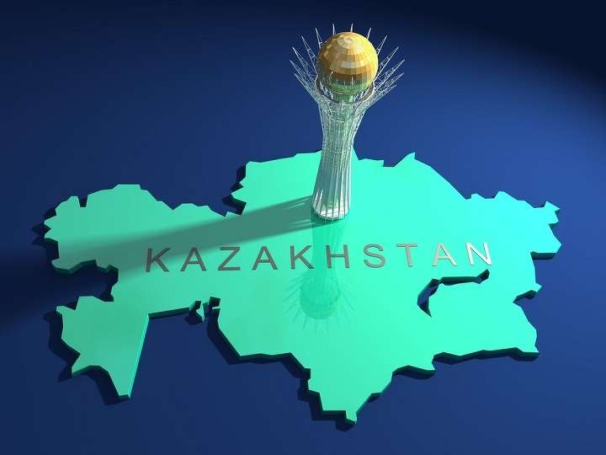
Kazakhstan

Slide 2

Landscape Kazakhstan from space in 3-D format

Slide 3
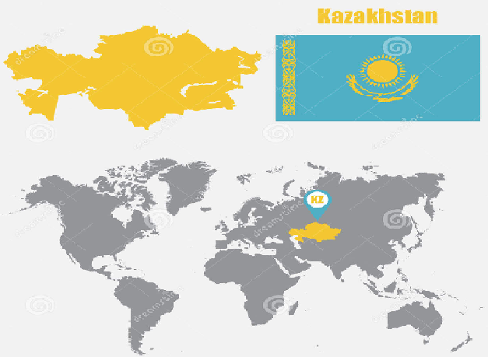
18,5 million Population
17 Regions
Capital: Nur-Sultan (Astana)
Currency: Tenge (KZT)
Languages: Kazakh, Russian

Slide 4
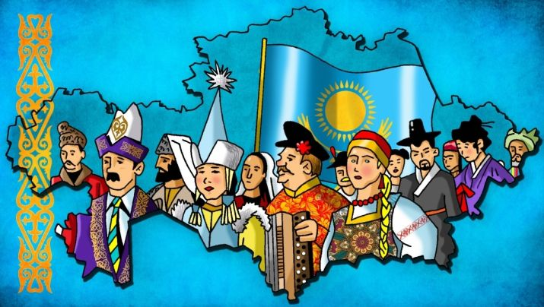
Currently around 125 nationalities populate Kazakhstan

Slide 5

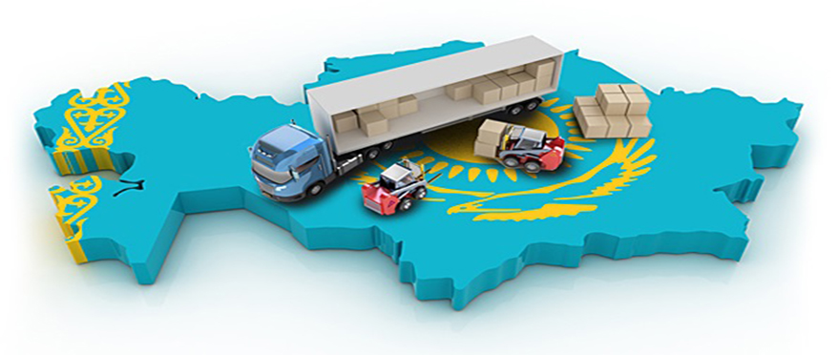
16 thousand kilometers of Railways
highway "Western Europe-Western China"

Slide 6


Economy of Kazakhstan 28th place in the ranking of World Bank Doing business
Drivers of Kazakhstan's economy: it-technologies, FinTech technologies, gas transportation, logistics with transport services and construction.

Slide 7

Accounting

Slide 8



Slide 9


For the academic year 2018-2019, 53,594 General education grants (state order) have been allocated in the Republic of Kazakhstan.

Slide 10

Ministry of finance
The audit Committee

