Slide 1
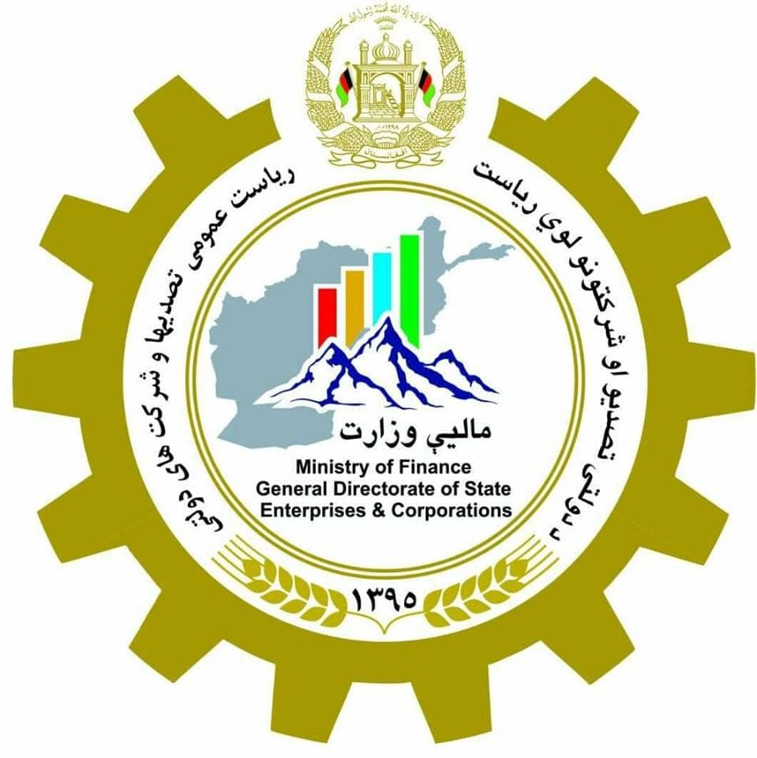
state Owned Enterprises &
Corporations (SOECs) General Directorate
Islamic Republic of Afghanistan
Ministry of Finance
Bishkek

Slide 2
Contents
Economic Importance
New State Owned Corporations Law 2018
Challenges
Plans
Opportunities for Investment (Govt Investment Packages)
Economic Development

Slide 3
The economic importance of SOEs &Cs
In the past, more than 70 SOEs accounted for about 60% of government revenue.
Due to the negative effects of the last three decades, the SOEs reduced to 35 and only carry less than 1% of state revenues.
The number of employees has also declined rapidly.
Having vast opportunity to play in the Economy of the Country.

Slide 4
State Owned Enterprises
No # | SoEs Name | Field of Work/Status | No # | SoEs Name | Field of Work/Status
1 | North Coal Mining SoE | Coal Extraction/Trade | 19 | Kandahar Fruits SoE | Not Functioning
2 | Mazar Electricity & Feltilizer SoE | Organic Fertilizers | 20 | Hotels SoE | Afghanistan Hotels Mgt
3 | Afghan Gas SoE | Gas Extraction/Energy | 21 | Afghan Tour SoE | Tourism Services
4 | Jabal-u-Seraj Cement SoE | Cement Factory | 22 | Azadi Printing Press SoE | Printing of Govt Magazines
5 | Metalic Elements Production SoE | Metalic Equipments | 23 | Slaughterhouse SoE | Meat Supply
6 | Helmand Construction SoE | Dam Constructions | 24 | Defense Construction Materials SoE | Construction Materials
7 | Marif Printing Press SoE | Printing of School Books | 25 | Central Frieghts Services SoE | Transportation of stuff
8 | Housing Construction SoE | Housing/Real State | 26 | Mili Bus (Public Transports) SoE | Public Transport
9 | Afghani Construction SoE | Govt Buildings Construction | 27 | Sukuk Printing Press SoE | Valuable Papers Printing
10 | Banaye Construction SoE | Buildings Construction | 28 | Pharmacy SoE | Medicine Production
11 | Food Trade & Destribution SoE | Food Supply/Trade | 29 | Macroryan Maintanence SoE | Maintenance/Services
12 | Fuel & Liquid Gas SoE | Fuel Management | 30 | Afghan Public Protection Force SoE | Protection/Guarding Services
13 | Balkh Cotton & Vegetable Oil SoE | Cooking Oil soaps etc | 31 | Prisons Industries SoE | Not Functioning
14 | Helmand Bost (Cotton & Vegetable Oil) SoE | Cooking Oil soaps etc | 32 | Central Silo (Store pit, Bread & Weat Storage) SoE | Bread Production
15 | Spinzar Kunduz (Cotton & Vegetable Oil) SoE | Cooking Oil soaps etc | 33 | Balkh Silo (Store pit, Bread & Weat Storage) SoE | Bread Production
16 | Balkh Textile SoE | Not Functioning | 34 | Modified Seeds SoE | Agricultural Services
17 | Kandahar Weaving SoE | Not Functioning | 35 | Pul-e-Khomri Silo (Store pit, Bread & Weat Storage) SoE | Bread Production
18 | Kandahar Textile SoE | Not Functioning

Slide 5
State Owned Corporations
No | State-owned Corporations (SoCs) | Field of Work /Status
1 | Ariana Afghan Airlines | Aviation
2 | Inter-Continental Hotel | Hotel
3 | Afghan National Insurance Company (ANIC) MoF | Insurance
6 | Afghanistan Urban Water Supply & Sewerage Corporation (AUWSSC) | Water and Canalization
9 | Afghan Textile | Textiles
4 | Afghan Telecom | Telecommunication
5 | Da Afghanistan Breshna Sherkat (DABS) | Electricity Distribution/Trade
14 | Nangarhar Valley Corporation | Agriculture
13 | Baghlan Sugar | Sugar /Not Functioning
7 | Helmand Joined Aragonite & Wood Work Factory. | Artistic Carpentry
8 | Afghan Card | Cards
10 | Afsotar (Transportaion) | Not Functioning
11 | Esteras (Hairatan Port Service) | Port/Border Services
12 | Afghan Poultry Company | Paultry
15 | Afghan Handicrafts | National Handicrafts
16 | Afghanistan High Security Printing | High Security Printings
17 | Aftanto (Import and distribution of Diversified & industrial Material) | Not Functioning

Slide 6
Challenges
No proper Law for Investment with SOCs
Following the Laws of 70’s and 80’s till date
Lack of Proffessionals/Qualified Human Resources
No Strategic/Business Plans
Lack of Latest Technology
No Awareness Programs for Investors
No Coordination between SOEs and SOCs
Political Interruptions /Decisions
Government Departments as ShareHolders

Slide 7
New State Owned Corporations Law
Based on the Current Economic Conditions (law of October 2018)
All the SOEs and SOCs to change their legal status till December 2019.
An Oversight Board lead by Minister of Finance with Four other Members (3 from Private Sector).
Ministry of Finance (Govt) as 100% Share holder (can be upto 25%)
All SOCs to be monitored, evaluated, directed and managed by one Board i.e. Oversight Board (SOCs General Directorate as Secretariat)
More Self Administered SOCs in their functions
Providing more Opportunities for Investors
Applying International Standards (GAAP, CCAP, IFRS etc)

Slide 8
Plans
Implementation of NEW SOCs Law
Preparation of Profiles for Each SOC
Conducting Meetings with Different Investors/Financial Institutes/Embassies etc
Meetings with Foreign Countries on sharing their Lessons Learned & Experience
Conduct Awareness Program [Business Expo] for the Investors on investment opportunities in Afghanistan with SOCs
Guide, Lead and Direct the SOCS with their Strategic and Business Plans

Slide 9
Investment Opportunities in AFGhanistan
Availability of Market in all Sectors
Availability of Infrastructure
Availability of Raw Materials (on site)
Availability of Required Property (Land)
Availability of Capital
Availability of Electricity (Energy)
Availability of Human Resources (Labor Force)
Assured Security
Transparent System of Investment and Profit in Return
Government of Afghanistan as Partner and Shareholder

Slide 10
Economic Development
Sustainable Development
Economy
Jobs
Taking Part of Local Investors
Stable Economy
Trustworthy Government
Job Creation
Poverty Reduction
Increase in GDP
Increase in Per Capita Income
Export of Goods & Products

Slide 11
Thank you
Afghanistan, Corridor to connect south Asia with central Asia and the west

