Slide 1
Thailand and Malaysia’s Incentive and Regulatory Design for SOE Performance
Pornchai Wisuttisak
Dean of Faculty of Law, Chiang Mai University, Thailand
PhD in Business Law and Taxation, UNSW
Email: pornchai.w@cmu.ac.th
Policy Workshop Reforming State-Owned Enterprises (SOE) in Central Asia: Challenges and Solutions
26–27 September 2019 Bishkek, Kyrgyz Republic

Slide 2
Outlines of paper presentation
Incentives for SOE Performance
Regulatory Design for SOE Performance
Experience from Thailand and Malaysia
Conclusion and suggestion

Slide 3
1.Incentives for SOE Performance
Flexibility
Efficiency
Benefit to the SOEs
Benefit to Social Economy

Slide 4
1.Incentives for SOE Performance
Political, Social and Economic Barriers
Political and social protests
Economic Conditions of commercialization and privatization of SOEs
Privatisation, Commercialisation, Coporatisation, and Competition as a Changes facilitators

Slide 5
2. Regulatory design
Regulatory design before the commercialisation/or privatization
Regulatory design for commercialisation and/or privatization
Regulatory design after the commercialisation and/or privatization

Slide 6
Regulatory design before the commercialisation/or privatization
Impact of Changes in SOEs
Feasibility and public acceptance with understanding
Country economic condition
Restructure and reform in sectors under SOEs
Consideration to dominance market power and control

Slide 7
Regulatory design for commercialisation and/or privatization
Regulation for open market
Regulation for implementation of SOEs privatization/comercialisation
Regulation for governance of market reform
Institution responsible for implementation of the set regulation for privatization/Comercialisation

Slide 8
Regulatory design after the commercialisation and/or privatization
Regulation for structural governance
Regulator to set up policy and implement laws and regulation in sectors
Concern over regulatory capture
Regulation for behavior controls- Competition law
Access to essential facility

Slide 9
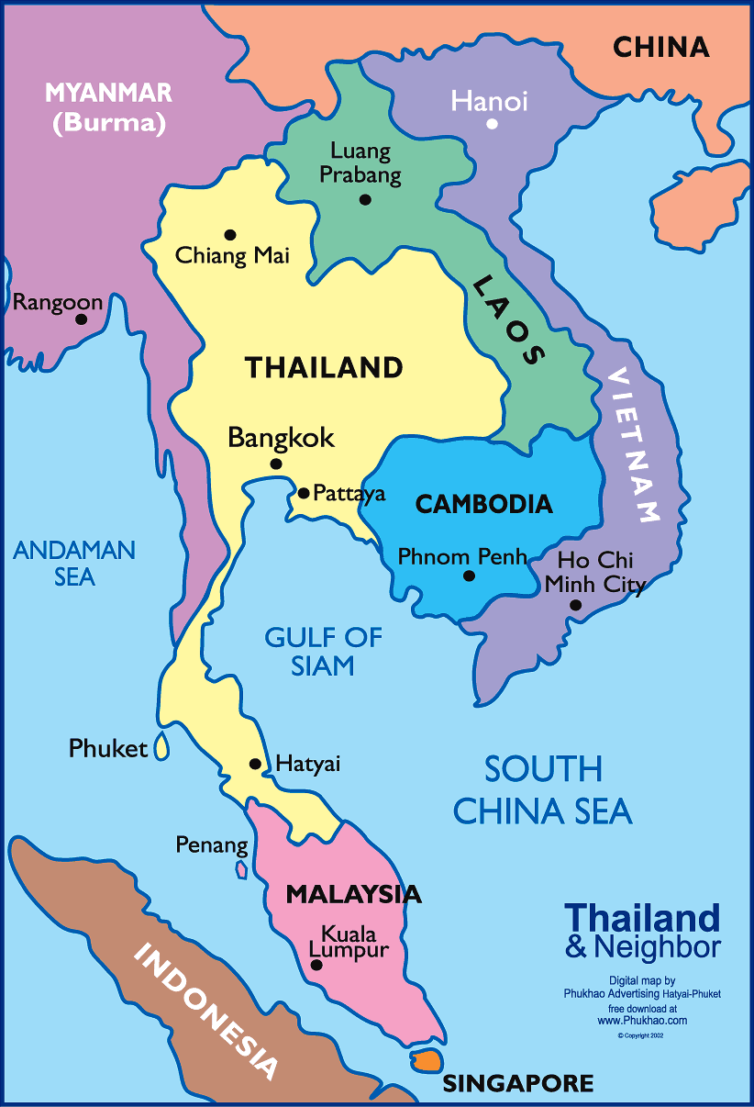
Thailand experience
 | 2013 | 2014 | 2015 | 2016 | 2017
Population (million) | 68.3 | 68.7 | 68.8 | 69.0 | 69.1
GDP per capita (USD) | 6,172 | 5,937 | 5,819 | 5,970 | 6,591
GDP (USD bn) | 422 | 408 | 401 | 412 | 455
Economic Growth (%) | 2.7 | 1.0 | 3.0 | 3.3 | 3.9
Source:https://www.focus-economics.com/countries/thailand
Picture Source:https://www.pinterest.com/pin/338755203191521843/

Slide 10
Privatisation and liberalization policy in Thailand
SOEs have continue to play an important role as revenue earners for the state and as a major part of the national economy.
The government creats and uses SOEs to sustain national sovereignty and security, develop infrastructure, stimulate economic growth, build basic infrastructure and provide essential goods and services.

Slide 11
Privatisation and liberalization policy in Thailand
SOEs in Thailand, and their subsequent privatisation, can usefully be divided into four broad periods as follows:
  The expansion of SOEs under constitutional monarchs and military regimes (1932-1960);
  The development of privatisation policy in parallel with the establishment of SOEs (1961 to 1997); and
  The implementation of privatisation policy (1998-2006),
  The public criticized about implemenetation of the policy and unstable politics in Thailand 2006-2018
Source: Chulajata, Issariyaporn, 2006, Policy transfer in privatisation : Thailand's experience with telecommunications

Slide 12
Privatisation and liberalization policy in Thailand
The expansion of SOEs (1932-1960)
  Until the 1930s, Siam was ruled as an absolute monarchy and the economy was mainly run by barter transactions.
  The State monopolised foreign trade, and warehousing provided a substantial part of the royal revenue from them
  This period witnessed the continuation of the long-standing tradition of royal monopoly and the establishment of SOEs to provide services to the public and, in the later stages, to strengthen Siam’s security and modernisation during the period of colonial expansion by European nations.
  King Rama V launched notable public finance reforms that prevented the country from insolvency
  Newly formed SOEs were essential instruments for strengthening and developing the economy of Siam during the period of colonial expansion, and for developing national infrastructure and the economy.
Source: Chulajata, Issariyaporn, 2006, Policy transfer in privatisation : Thailand's experience with telecommunications
Notes:
The expansion of SOEs (1932-1960)
Until the 1930s, Siam was ruled as an absolute monarchy and the economy was mainly run by barter transactions.
The State monopolised foreign trade, and warehousing provided a substantial part of the royal revenue from them
This period witnessed the continuation of the long-standing tradition of royal monopoly and the establishment of SOEs to provide services to the public and, in the later stages, to strengthen Siam’s security and modernisation during the period of colonial expansion by European nations.
King Rama V launched notable public finance reforms that prevented the country from insolvency
Newly formed SOEs were essential instruments for strengthening and developing the economy of Siam during the period of colonial expansion, and for developing national infrastructure and the economy.

Slide 13
Privatisation and liberalization policy in Thailand
The development of privatisation policy in parallel with the establishment of SOEs (1961 to 1997)
  Thai during 1960s adopted the World Bank’s economic strategy for initiating private involvement in industry and trade.
  In 1961, its first National Economic and Social Development Plan (NESDP), the government ruled out direct competition with the private sector and promote private sector investment in the industrial sector
  Thai Ministry of Finance declared that Thailand first developed privatisation and encouraged private sector participation in 1961 as mentioned in the first National Economic and Social Development Plan (NESDP)
  Parallel promotion of SOEs and of the private sector and by privatisation coming onto the government’s policy agenda
Source: Chulajata, Issariyaporn, 2006, Policy transfer in privatisation : Thailand's experience with telecommunications

Slide 14
Privatisation and liberalization policy in Thailand
The development of privatisation policy in parallel with the establishment of SOEs (1961 to 1997)
  Despite the increased strength of the private sector, some bureaucrats were still able to mobilise allies to prevent major private sector encroachment into SOE territory.
  SOE employees were particularly willing to aid the bureaucrats in this political campaign. The analysis of academics concerning the ‘bureaucratic polity’ between 1930s and 1980s supports the notion that elements of the Thai bureaucracy blocked significant attempts at reforming SOEs
Source: Chulajata, Issariyaporn, 2006, Policy transfer in privatisation : Thailand's experience with telecommunications

Slide 15
Privatisation and liberalization policy in Thailand
The implementation of privatisation policy (1998-2006)
  Peak Privatisation implementation with many SOEs had been commercialized and privatized
  The Asian Financial Crisis of 1997. This hit Thailand particularly hard, resulting in unemployment, the collapse of businesses, a shortage of capital and reduced economic growth.
  Responding to the financial crisis, Thailand opened up policy space and allowed radical policy initiatives
  In the two decades prior to the financial crisis, Thailand was reluctant to privatise SOEs that earned profits
  As a result of the 1997 Asian Financial Crisis, the Thai government accelerated the privatisation programme, and improve the legal framework for private sector participation in the economy, including the law on corporatisation
Source: Chulajata, Issariyaporn, 2006, Policy transfer in privatisation : Thailand's experience with telecommunications

Slide 16
Privatisation and liberalization policy in Thailand
The implementation of privatisation policy (1998-2006)
In addition to reforms already required by the 1997 Constitution, the IMF imposed further reforms such as privatisation, to signify Thailand’s commitment to market liberalisation.
Under letter of intend from Thaland to IMF
  the Thai government set out a concrete and specific agenda for privatisation, including:
    establish regulatory capacity with cabinet approval
    set up a timeframe and stages for the corporatisation and divestiture of selected SOEs responsible for energy, telecommunications, water and railways
    establish divestiture strategy for selected SOEs through ‘full or partial privatization through joint ventures, private placements or public offers.

Slide 17
Privatisation and liberalization policy in Thailand
The implementation of privatisation policy (1998-2006)
1998 was a significant year for privatisation, as the Ministry of Finance (assisted by the World Bank) drew up a Master Plan for State Enterprise Reform (or the Privatisation Master Plan, PMP) (Royal Thai Government, 1998c), outlining the objectives and 8-year timetable for the reform programme.
It also classified 59 SOEs under 5 main ministries covering 5 sectors: telecommunications, energy, transportation, water and others (industrial, commercial, agricultural, social and research).
The government regarded the Master Plan as a strategic document, that determined the direction and timing for implementing privatisation policy, and described steps towards the increasing role of the private sector in SOEs.

Slide 18
Privatisation and liberalization policy in Thailand
The implementation of privatisation policy (1998-2006)
The government also established the State Enterprise Policy Commission under the Office of State Enterprise and publicly announced Sectoral Plans in telecommunications, energy, transport and water.
The MOF separated the functions of policy maker, regulator and operator in 1998, developing a more systematic and centralised government regulatory structure for SOEs in which the Cabinet became the highest decision-making body for SOE policy and management

Slide 19
Privatisation and liberalization policy in Thailand
  The public criticized about implemenetation 2006-2018
  The political economy in Thailand is unstable due to political unrest
  Elected government under Prime Minister Taksin was critisised as a corrupted government.
  The Implementation of privatization and liberalization were directed to benefit interest groups not the public
  The lack of structureal and efficiency reforms in SOEs create a bias ideas of privatization and commercialization
  The implementation of privatization policy is halted but governments still maintain ideas of Private Public Partenership in order to draw investments toward infrastructure development

Slide 20

Picture Source: http://www.econnews.co.th/ปฏิรูป-รัฐวิสาหกิจไทย/
Notes:
จาก ‘แปรรูป’ สู่ ‘ปฏิรูป’ รัฐวิสาหกิจไทย?
‘รัฐวิสาหกิจไทย’มีแนวโน้มที่ขนาดสินทรัพย์และเงินลงทุนจะเพิ่มสูงมากขึ้นทุกปี เมื่อเทียบกับขนาดเศรษฐกิจหรือ GDP ของประเทศ แต่กลับมีส่วนร่วมในการสร้างรายได้และผลตอบแทนที่ค่อนข้างน้อย ทำให้เกิดการกระจุกตัวของทรัพยากรและสินทรัพย์ในประเทศในวงจำกัด การกระจายส่วนแบ่งที่ไม่เป็นธรรมจากผลประโยชน์การเติบโตทางเศรษฐกิจ และการสร้างผลตอบแทนที่ขาดประสิทธิภาพ เมื่อเทียบกับความได้เปรียบจากขนาด นอกจากนี้ ที่ผ่านมา ยังถูกแทรกแซงจากนักการเมืองเข้ามาใช้รัฐวิสาหกิจเป็นเครื่องมือในการทุจริตคอร์รัปชั่นและตอบสนองนโยบายประชานิยมที่ด้อยคุณภาพ
แนวทางปฏิรูปรัฐวิสาหกิจ จึงเป็นหนึ่งในงานหลักของรัฐบาลพลเอกประยุทธ์ จันทร์โอชา นายกรัฐมนตรี อย่างไรก็ตาม ยังคงมีข้อสังเกตต่อรูปแบบแนวทางในการปฏิรูป โดยเห็นว่าไม่ควรยึดถือรูปแบบของการรวมศูนย์อำนาจและความเป็นเจ้าของ แต่ต้องลดการครอบครองและผูกขาดทรัพยากร รวมทั้งความได้เปรียบในกลไกการแข่งขันของรัฐวิสาหกิจ เพื่อก้าวสู่แนวคิดใหม่ในการส่งเสริมอำนาจบริหารจัดการทางเศรษฐกิจ กระจายและทุ่มเททรัพยากรให้กับภาคเอกชนในการเร่งลงทุน ดำเนินธุรกิจสร้างรายได้และผลตอบแทนที่จะขับเคลื่อนการเติบโตเศรษฐกิจอย่างยั่งยืน

Slide 21
Thailand experience
Liberalisation and Privatization - Energy
Liberalisation and Privatization- Telecommunication
Liberalisation and Privatization- Airlines

Slide 22
Liberalisation and Privatization - Energy
The initial step of electricity liberalisation occurred in 1992 with the introduction of private participation of independent power producers (IPPs) and small power producers (SPPs) in the electricity sector.
Electricity Generating Authority of Thailand Act B.E. 2511(1968) amendment No. 5(1992).
I: Reform of Electricity Supply Industry (ESI)
II: Using EGAT as the primary power purchaser (1998-2001)
III: EGAT as the central supplier of power, with gradual introduction of competition. (2001-2003)
IV: Competitive wholesale power pool / introduction of retail competition (From year 2003 onward)
Source: Wisuttisak (2013) ‘Competition law and the development and regulation of the Thai Electricity Sector’, UNSW Thesis

Slide 23
Failure of Implementation;
Supreme Administrative court decision on EGAT corporatisation and privatisation
1.Energy Regulatory Commission
2. Open Market with maintenance of Dominance power of SOEs in Electricity
Source: Wisuttisak (2013) ‘Competition law and the development and regulation of the Thai Electricity Sector’, UNSW Thesis

Slide 24
Competition law exemption to SOEs
Electricity Authority of Thailand (EGAT) is a monopoly of generation and electricity trade under enhanced single buyers scheme.
Generation sector
Transmission sector
EGAT is a monopoly of Transmission sector
Provincial Electricity Authority (PEA)
Metropolitan Electricity Authority (MEA)
Distribution sector
Consumers in Provincial Areas
Consumer in Metropolitan areas
Retail sector

Slide 25
Liberalisation and Privatization- Telecommunication
ADB funded three technical assistance packages for privatisation in 1992–1993, including one for Telecommunications Restructuring and Privatisation
The Steering Committees of the TOT, CAT and MOTC agreed with the international consultants' pro-privatisation recommendations and incorporated them into the final draft of the Telecommunications Master Plan (TMP) approved by the Cabinet in 1995.
1997 Fincial Crisis-→ IMF →State domination through its giant SOEs was no longer acceptable.
Issariyaporn Chulajata & Mark Turner, 2009, What Happens When Policies Are Transferred? The Privatisation Of The Telephone Organisation Of Thailand,
IJAPS Vol. 5, No. 1, 33–53, 2009

Slide 26
Liberalization and Technological advancement of Telecommunication
Mobile network liberalization with new structure of market competition
The Act on Organization to Assign Radio Frequency and to Regulate the Broadcasting and Telecommunications Service B.E. 2553 (2010) which has become effective since 20 December 2010
Establishment of National Broadcasting and Telecommunications Commission (NBTC) having powers and duties to assign the frequencies and to regulate the broadcasting and telecommunications
NBTC
Telecom
Broadcasting
Spectrum Management

Slide 27
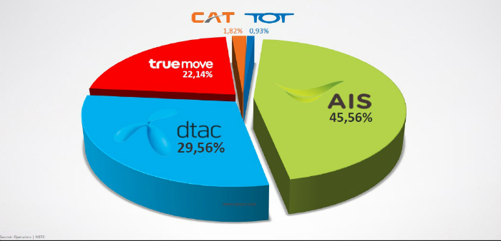
Current Market structure of Mobile phone providers in Thailand
Picture Source: http://www.veedvil.com/tech/mobile-gadget/mobile/mobile-users-and-smartphone-in-thailand-2015/

Slide 28
Liberalisation and Privatization- Airline
The partial privatization of Thai Airways International was completed by November 2000
The share was traded in Thai Stock market with the Ministry of Finance as the major share holders up until current
Source: Thai Airway, Annual Report, 2017

Slide 29

Airlines Operators in Thailand after privatization and liberalisation
Picture Source: https://www.industrialnew.com/2016/05/05การบินประเทศไทย-ความสำเ/

Slide 30
Liberalisation and Privatization- Airline
Liberalization of Air Transport in Thailand and Global Market
ASEAN Open Sky Policy and Implementation
Financial Loss to Thai Airway under fierce airline competition
Better adaptability and improve of efficiency in Thai Airway as a SOEs

Slide 31
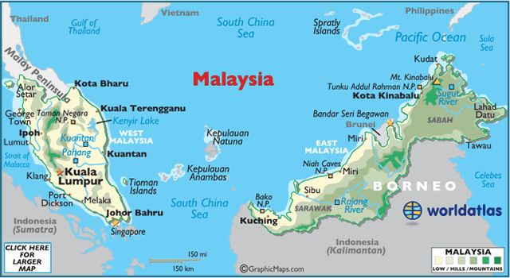
Malaysia Experience
 | 2013 | 2014 | 2015 | 2016 | 2017
Population (million) | 30.2 | 30.7 | 31.2 | 31.6 | 32.1
GDP per capita (USD) | 10,723 | 11,063 | 9,573 | 9,435 | 9,806
GDP (USD bn) | 324 | 340 | 299 | 298 | 314
Economic Growth (GDP,%) | 4.7 | 6.0 | 5.1 | 4.2 | 5.9
Source: https://www.focus-economics.com/countries/malaysia
Picture Source: https://www.worldatlas.com/webimage/countrys/asia/my.htm

Slide 32
Privatisation and liberalization policy in Malaysia
The privatisation wave in Malaysia had its beginnings in 1983.
Prime Minister Mahathir Mohamad publicised announced intention to establish a privatisation policy.
The Privatisation Policy was launched in 1983 to support the Malaysia Incorporated Policy towards increasing the private sector's role in the country's economic development.
The main objective of this policy is to lessen the financial and administrative burden of the Government, improve skills and production, accelerate economic growth, reduce the size and involvement of the public sector in the economy, and to assist in reaching the country's economic policy's goal.
.
Source: Malaysia Ministry of Finance, 2018, -http://www.ukas.gov.my/en/latar-belakang

Slide 33
Privatisation and liberalization policy in Malaysia
By the implementation of the policy, a Privatisation Committee (in the earlier days known as the Privatisation Special Task Force) was established by the Government
The Economic Planning Unit of the Prime Minister's Department (EPU, PMD) was the secretariat to the Privatisation Committee, which in turn is made up of various agencies working towards finalising and confirming the proposals on privatization for the Ministers' Council's approval.
In 1985 the Government produced a Guideline On Privatisation which detailed out the objective of the policy, method of privatization, as well as the implementation mechanism.
In 1991 the Government produced a Master Plan on Privatisation to explain the policy and strategy for privatization.
Source: Malaysia Ministry of Finance, 2018, -http://www.ukas.gov.my/en/latar-belakang

Slide 34
Privatisation and liberalization policy in Malaysia
In February 1991, the Privatisation Masterplan (PMP) was announced. This plan set out the country's privatisation policies. In formulating its privatisation policy, the government aimed to achieve the following objectives:
  i. To relieve the financial and administrative burden of the government;
  ii. To improve efficiency and increase productivity;
iii. To facilitate economic growth;
iv. To reduce the size and presence of the public sector in the economy;
v. To assist in meeting the national development policy targets.
Source: Shankaran Nambiar, 2009, Revisiting Privatisation in Malaysia: Institutional Process, Asian Academy of Management Journal, Vol. 14, No. 2, 21–40

Slide 35
Privatisation and liberalization policy in Malaysia
The Malaysia government adopted the Privatisation Action Plan (PAP),a two-year rolling plan to facilitate privatiation implementation. The PAP was reviewed annually as to pin point measures to expedite the implementation of the programme and to determine the entities to be privatised in the following two years.
The PAP was guided by a study undertaken by private consultants who were commissioned by the government to review the advisability of privatising government-owned entities (GOEs).
Source: Malaysia Ministry of Finance, 2018, -http://www.ukas.gov.my/en/latar-belakang

Slide 36
Privatisation and liberalization policy in Malaysia
Amongst the achievements in the implementation of the national privatization policy are:
Provided infrastructure facilities of world class stature such as the North - South Highway, the development of the Light Rail Transit (LRT), the Tanjung Pelepas Port and the development of the Kuala Lumpur International Airport (KLIA) projects;
Created local conglomerate companies which are successful and competitive such as the Tenaga Nasional Berhad (National Electricity Board) and Telekom Malaysia Berhad;
Provided employment opportunities in the private sector apart from producing a professional work force, especially amongst the Bumiputra; and
Energised the country's capital market through capital investments of the private sector in privatised Government projects
Source: Malaysia Ministry of Finance, 2018, -http://www.ukas.gov.my/en/latar-belakang

Slide 37

Privatisation and liberalization policy in Malaysia
Since the introduction of the privatization programme from 1983 to April 2009, about 500 privatised projects have been implemented throughout the country.
The Government has benefited through savings in the form of capital expenditure amounting RM161 billion and annual management expenditure (operations) amounting to RM7.79 billion (or an estimated RM25 billion in a 25 year period).
The burden of the Government's administrative expenditure was successfully reduced following the privatisation of 58 Government agencies which involved the transfer of 113,440 government employees to the private sector.
This savings has enabled the Government to redistribute its limited development resource to more needy sectors such as the education, health and poverty eradication programme.
Source: Malaysia Ministry of Finance, 2018, -http://www.ukas.gov.my/en/latar-belakang

Slide 38
Source: Economic Planning Unit, Prime Minister's Department, 2003, The Malaysian Economy in Figures
2013

Slide 39
Malaysia Experience
Liberalisation and Privatization - Energy
Liberalisation and Privatization- Airlines
Liberalisation and Privatization- Telecommunication

Slide 40
Liberalisation and Privatization - Energy
TENAGA NASIONAL BERHAD (TNB) and Privatisation
1965, Central Electricity Board (CEB) of the Federation of Malaya was renamed as the National Electricity Board of the States of Malaya (NEB).
two pieces of legislation were passed to replace the existing Electricity Act, and to provide for the establishment of a new corporation – TENAGA NASIONAL BERHAD (TNB), purposefully replacing the NEB (Successor Company Act).
On 1 September 1990, Prime Minister Dato Seri Dr. Mahathir bin Mohamad officially proclaimed TNB as the heir and successor to NEB. TNB became a private company wholly-owned by the government; on the same day, Tan Sri Dato Haji (Dr) Ani bin Arope was appointed Chairman.
Source: https://www.tnb.com.my/about-tnb/history

Slide 41
After privatisation, TNB has introduced a number of measures to improve customer services. They include:
Establishing outlets
Providing a dedicated national hotline
Minimising estimated reads through the use of telescopic devices.
Installing meters with a transparent casing
Providing a minor repair service to customers at a nominal charge
Offering advice to customers on power quality, demand side management and energy efficiency.
Source: https://www.metering.com/regional-news/asia/privatisation-of-the-power-sector-a-malaysian-success-story/
Notes:
Establishing outlets (known as TNB Shops) in major shopping complexes for payment of bills and as customer information centres. The number of payment points was also increased.
Providing a dedicated national hotline, to enable customers to lodge complaints regarding outages. Each complaint is given a number for easy identification, and customers are contacted if the supply cannot be restored within a certain time.
Minimising estimated reads through the use of telescopic devices.
Installing meters with a transparent casing, for easy detection of defects or tampering.
Providing a minor repair service to customers at a nominal charge, if a breakdown has been caused by a defect in the customer’s electrical installation.
Offering advice to customers on power quality, demand side management and energy efficiency.

Slide 42
Privatisation Liberlisation and Reform
  Governments no longer see themselves as wholly responsible for this and are encouraging the private sector to be involved as much as possible
Increasing Competition in Malaysia’s Electricity Sector
Development of Regulation and market governance
Source: ISIS Malaysia. (2014). Reforming Peninsular Malaysia’s Electricity Sector: Challenges and Prospects. KualaLumpur: Ins􀆟tute of Strategic and Interna􀆟onal Studies (ISIS) Malaysia.

Slide 43
Liberalisation and Privatization- Airlines
Malaysia Airlines (MAS) was incorporated as Malaysia’s flag carrier in 1971 following the breakdown of Malaysia-Singapore Airlines partnership
Under the Government’s privatisation plan, MAS became the first governmental agency to go partly private in 1985.
The Government sold 40 per cent to the public and Brunei Investment Agency, while keeping total 60 per cent in the hands of Malaysian Central Bank Negala and local Governments.
1998,MAS lost $70 million and reported more loss in the next fiscal year due to the Asian economic crisis
Government tightly control and manage efficiency of the MAS

Slide 44
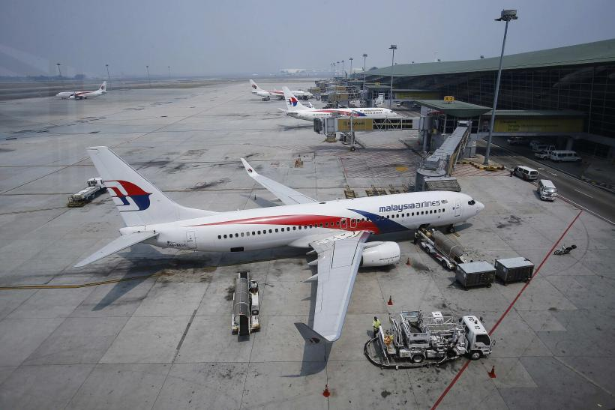
ASEAN Open Sky policy create competition in Air transport market for MAS
MAS tends to face with financial loss but receive funding from government as to maintain its operation and business.
Recently, Khazanah, the investment fund owned by the Malaysian government, which currently holds a 69 percent stake in the company, is reportedly contemplating a range of measures,
Picture Source: https://www.cnbc.com/2014/08/07/malaysia-airlines-says-state-fund-khazanah-to-offer-14-billion-ringgit-in-privatization.html

Slide 45
Liberalisation and Privatization- Telecommunication
In the telecommunications sector, reforms began in 1983 when the government allowed the private sector to complement Jabatan Telekom Malaysia(JTM) in the supply of terminal equipment such telephones and teleprinters.
the telecommunications sector was being liberalized in the early 1980s, plans were already afoot to privatize JTM. By 1985, a series of legislative changes were carried out to make this possible. Two years later, on January 1, 1987, Syarikat Telekom Malaysia Berhad (STM) officially took over the operational responsibilities of JTM
Subsequently, the government sold 25 per cent of STM’s equity to the public via a public listing exercise in 1990. (With the public listing, STM was renamed Telekom Malaysia Berhad or TMB).
Source: Lee, Cassey & Wilson, Fiona & Secretary, Centre. (2002). Telecommunications Reforms in Malaysia.

Slide 46
Liberalisation and Privatization- Telecommunication
After the privatization of TMB, the government continued to liberalize the telecommunications market despite having substantial shareholding interests in the incumbent firm
Between 1993 and 1995 five additional licenses to operate in the fixed line market were approved
Despite the increase in the number of participants in the fixed line market, the incumbent’s (TMB) market share remained unchallenged
Source: Lee, Cassey & Wilson, Fiona & Secretary, Centre. (2002). Telecommunications Reforms in Malaysia.

Slide 47
Liberalisation and Privatization- Telecommunication
The cellular phone services market compared to the fixed-line market meant that the issuance of new licenses in the former introduced new competitors in the market.
Aside from market entry via the issuance of licenses, technological change has been an important contributing factor to the intensification of competition in the cellular phone service market.

Slide 48
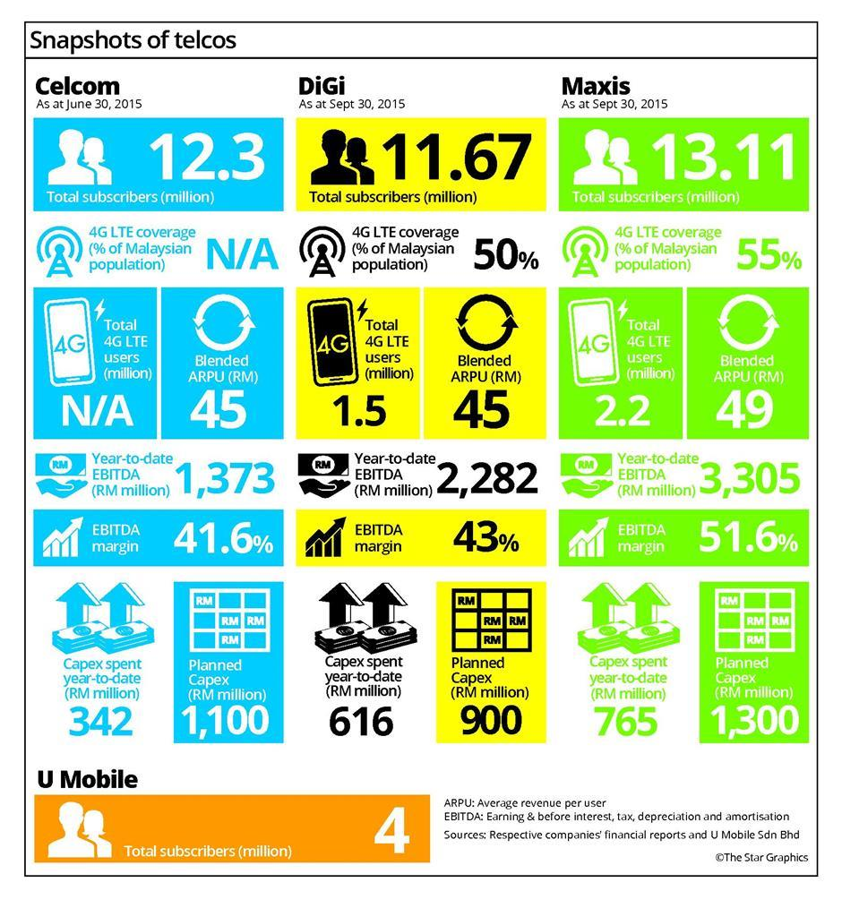
Liberalisation and Privatization- Telecommunication
Source: https://www.thestar.com.my/business/business-news/2015/11/21/fight-for-supremacy/

Slide 49

Khazanah Nasional Berhad- Governemnt Investment Fund
Khazanah Nasional Berhad is the strategic investment fund of the Government of Malaysia. We are entrusted to hold and manage the commercial assets of the Government, and to undertake strategic investments on behalf of the nation.
State Management of Investment and Market for mega projects with SOEs and liberalized markets.
Picture Source: https://www.thestar.com.my/business/business-news/2017/11/29/khazanah-calls-report-misleading-and-asserts-shareholder-return-is-9pt3pc/

Slide 50
Conclusion
Reform and Privatization must be implemented under objective to ascertain economic efficiency
Structural changes and open of market should be planned
Regulation before, for and of the sectors must be appropriately considered
Market competition and efficiency should be a main goals of privatization, commercialization or corporatization.
Regulation and competition law under some issues of dominance market power.
Funds and investments with a consideration on efficiency and development is a must

Slide 51
Reference
Graham C. & Smith F., 2004, Competition, Regulation and the New Economy, Hart publishing, Oregon USA.
ICAO Secretariat, 2007, Privatization and re-nationalization of Malaysia Airlines - ICAO
Issariyaporn Chulajata & Mark Turner, 2009, What Happens When Policies Are Transferred? The Privatisation Of The Telephone Organisation Of Thailand, IJAPS Vol. 5, No. 1, 33–53, 2009
ISIS Malaysia. (2014). Reforming Peninsular Malaysia’s Electricity Sector: Challenges and Prospects. KualaLumpur: Institute of Strategic and International Studies (ISIS) Malaysia.
Moran M., Prosser T.,1994, Privatisation and Political Change in Europe ,Open University Press, Buckingham.
Wisuttisak, P., Regulation and competition issues in Thai electricity sector, (2012) Energy policy, Vol 44 , Issue, 185–198
Wisuttisak, P., Liberalisatioin of Thai Energy sector: a consideration of competition law and sectoral regulation , (2012), Journal of World Energy Law & Business, Vol 5, Issue 1, 60-77.
Wisuttisak, P.,(2014), EU competition law on electricity sector liberalization, International Journal of Public law and Policy
Wisuttisak, P., 'The rise of PPPs and big government in ASEAN utility infrastructure market: the consideration on the ASEAN market governance under competition law and policy' (Paper presented at the New Approaches to Building Markets in Asia, Lee Kuan Yew School of Public Policy, Singapore, 2011)

Slide 52

Thank you
Спасибо
ขอบพระคุณครับ
Pornchai Wisuttisak*
Dean of Faculty of Law, Chiang Mai University, Thailand
PhD in Business Law and Taxation, UNSW
Email: pornchai.w@cmu.ac.th
Courtesy of ASEAN National Tourism Organisations

