Slide 1


Embracing the E-commerce Revolution in Asia and the Pacific with a focus on the CAREC members
Tengfei WANG
Economic Affairs Officer
Trade, Investment and Innovation Division
United Nations Economic and Social Commission for Asia and the Pacific
Some slides are based on a joint ADB-ESCAP report titled “Embracing the E-commerce Revolution in Asia and the Pacific”. Jong Woo Kang from ADB and Tengfei Wang from ESCAP led the preparation of the report.
The views expressed in this presentation are those of the speaker and do not necessarily reflect the views of any organizations

Slide 2
Key messages
  E-commerce is moving ahead, whether we like it or not.
  E-commerce revolution in Asia and the Pacific (including CAREC) presents vast economic potential.
  E-commerce market in the region remains highly heterogeneous in (i) economic factors and conditions, (ii) legal and institutional environment and (iii) social acceptance
  Developing an e-commerce ecosystem requires a holistic approach and concerted efforts by all stakeholders
  Partnership including partnering with regional e-commerce platforms is key to support developing countries and the least developed countries and make e-commerce inclusive

Slide 3
Factors Affecting the Development of E-marketplace
Economic
Social Acceptance and Awareness
● Affordability and access to ICTs
● Bandwidth availability
● Availability of online payment options
● Delivery infrastructures
● Economies of scale
Firm level
● Confidence, risk aversion, and inertia
● Awareness, knowledge and understanding of e-commerce opportunities
Consumer level
● Awareness and knowledge of e-commerce benefits
● General and computer literacy
● English proficiency
● Trust in e-commerce vendors and postal services
● Perception of foreign products/vendors
Individual
readiness
for e-commerce
E-marketplace
development
Environmental
readiness
for e-commerce
Legitimacy to
participate in
e-commerce
Legal and Institutional
Normative institutions
● Importance of personal relationships in business
● Roles played by industry bodies and trade/professional associations
Regulative institutions
● Legislative measures related to
e-commerce
● Measures making e-commerce affordable and accessible
● Policy initiatives that directly facilitate e-commerce activities
● Public-private partnership
programs
Economic
Legal and Institutional
Social Acceptance and Awareness
Economic environment that affects accessibility and viability of
e-commerce activities
Social and political environment that plays roles in the evolution of the legitimacy of e-commerce-related activities
Internalized norms that affect
e-commerce-related behaviors of individuals and organizational decision-makers
ICT = information and communications technology.
Source: ADB compilation based on Kshetri (2007a, 2018a), North (1996), Parto (2005), Scott (1995, 2001), and World Bank (2016a).

Slide 4
Asia and the Pacific is the largest and fast growing e-commerce market
Comparison of Internet Retailing Market Size, 2017-2021 (forecast)
Note: Market size refers to the total goods and services sold through internet retail market. See Box 1.1 for the definition of internet retailing. Asia and the Pacific comprises of Australia; Azerbaijan; Hong Kong, China; India; Indonesia; Japan; Kazakhstan; Malaysia; New Zealand ; the People’s Republic of China; the Philippines; Singapore; the Republic of Korea; Taipei,China; Thailand; Uzbekistan; and Viet Nam.
Source: Kshetri (2018) using data from Euromonitor International. Passport database.
Notes:
Asia and the Pacific also does well in terms of the market size of internet retailing, a subset of B2C e-commerce (Figure 1.3). In 2017, the combined internet retailing market share of Asia and the Pacific was already above that of North America and Europe combined. According to Euromonitor International, the global internet retailing market share of Asia and the Pacific will reach 48.5% of the global total in 2021 compared with 47.2% in 2017 (Kshetri 2018a).

Slide 5
It is also the largest as % of GDP
Global E-commerce
(% of GDP)
Regional E-commerce, 2015
(% of GDP)
GDP = gross domestic product.
Note: Business-to-Consumer (B2C) e-commerce covers any contract for the sale of goods and/or services, fully or partially concluded by a technique for distance communication. Values refer to the total of goods and services sold through B2C transactions as a percentage of GDP.
Source: Ecommerce Foundation (2016).
Notes:
E-commerce is clearly growing in economic activities (Figure 1.2). The share of e-commerce in global gross domestic product (GDP) rose from 1.3% in 2011 to 3.1% in 2015. Its contribution to the economy is most prominent in the Asia and Pacific region. By the end of 2015, the size of e-commerce relative
to GDP was 4.5% in Asia and the Pacific—the highest among regions globally. In comparison, the share of e-commerce in regional GDP stood at 3.1% and 2.6% in North America and Europe, respectively. E-commerce held even lower shares in Latin America (0.8% of regional GDP) and the Middle East and North Africa (0.7%).

Slide 6
ICT Infrastructure
Key ICT Indicators by Region, 2016 (per 100 inhabitants)
Source: International Telecommunication Union. Statistics. https://www.itu.int/en/ITU-D/Statistics/Pages/stat/default.aspx
Mobile and Fixed Broadband Speed—Central and West Asia, South Asia, and Southeast Asia,
as of December 2017 (megabits per second, download)
Source: Speedtest. Speedtest Global Index December 2017. http://www.speedtest.net/global-index
Notes:
While the availability of broadband internet connections has been a key factor in fueling its growth, e-commerce requires substantial ICT infrastructure that allows sellers to transact business with buyers. Figure 3.2 presents key ICT indicators—fixed and mobile telephone, computer, and the internet penetration levels. It shows that developing economies and LDCs perform poorly compared with developed countries in terms of the economic and infrastructural factors needed to participate in e-commerce. Notably, all groups show an inclination toward mobile versus fixed telephone subscriptions, as well as an inclination toward mobile broadband subscriptions versus fixed broadband subscriptions.
Figure 3.3 uses the same indicators as above, but with economies grouped by region. It also shows that, across all regions, mobile subscriptions are more prevalent to fixed subscriptions, and that mobile broadband subscriptions are more widely used than fixed broadband subscriptions. Asia and the Pacific performs better than Africa and Arab States in most indicators, but lags behind other regions.7
Figure 3.6 shows the low bandwidth availability in LDCs and developing countries in Central and West Asia, South Asia, and Southeast Asia. A lower bandwidth means a longer time is needed to transfer data and hence low relative advantage of using the internet and e-commerce. By region, in 2016, the international internet bandwidth per internet user in Asia and the Pacific was 48 kilobit per second (KBPS), below Africa’s 51 KBPS. As a region, only the Arab States had lower international internet bandwidth per internet user (39 KBPS) than Asia and the Pacific. For comparison, developing economies’ international internet bandwidth
per internet user stood at 53 KBPS (ITU 2017).9

Slide 7
Ranking according to the United Nations Conference on Trade and
Development B2C E-commerce Index 2018

Slide 8
Fixed-broadband subscriptions per 100 habitants in ESCAP member countries, 2017 or latest
Source: ESCAP, based on data from ITU (2017) World Telecommunication/ICT indicators database (2018). (accessed on 17 January 2019).

Slide 9
E-commerce in selected CAREC members (1)
Kazakhstan’s e-commerce market is growing 55% annually and the market value is $3.6bn (Kazakh TV, 2016; PPRO Financial, 2018).
In Azerbaijan the key drivers of internet usage and online shopping growth are under 25 years old (yStats.com 2015).
In Uzbekistan, mobile technologies promoted internet penetration. Key market players include aliexpress.com, eBay and Amazon.com
In Georgia, In 2017 the project “Internetization of Tusheti” covered dozens of villages and areas in the mountainous areas of Georgia with wireless internet (in cooperation with private sector)

Slide 10
E-commerce in selected CAREC members (2)
Pakistan: 1) E-commerce sales going to reach $1bn by the end of year 2018; 2) 85% of the e-commerce sales are based on cash on delivery (COD); 3) No. of internet users in the country have increased from 44.5 million to 52 million – one of the basic causes of increase in e-commerce trading
Source: Workshop on Environmental Readiness for E-Commerce: Economic, Legal, and Institutional Factors. Country presentation
https://www.carecprogram.org/?event=workshop-ecommerce-readiness-dec-2018

Slide 11
E-commerce in selected CAREC members (3)
Afghanistan:

Slide 12
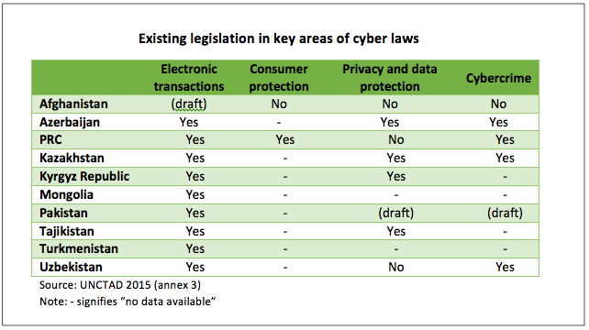
Legislation in key areas of cyber laws
Notes:
Figure 3.13 illustrates the number of Asia and Pacific economies at various stages of legislation affecting e-commerce.20 Most economies have some type of electronic transaction and cybercrime legislation, while many are lax when it comes to privacy and data protection and consumer protection laws.

Slide 13
Cross border e-commerce: key issues
  Market access: contains a wide range of topics including customs duties, valuation issues, movement of natural persons and access to data;
  Rules and regulations: touch on different issues including intellectual property rights, protection of personal information, consumer protection and competition;
  Facilitation: covers areas on paperless trade, e-signatures and digital authentication.

Slide 14
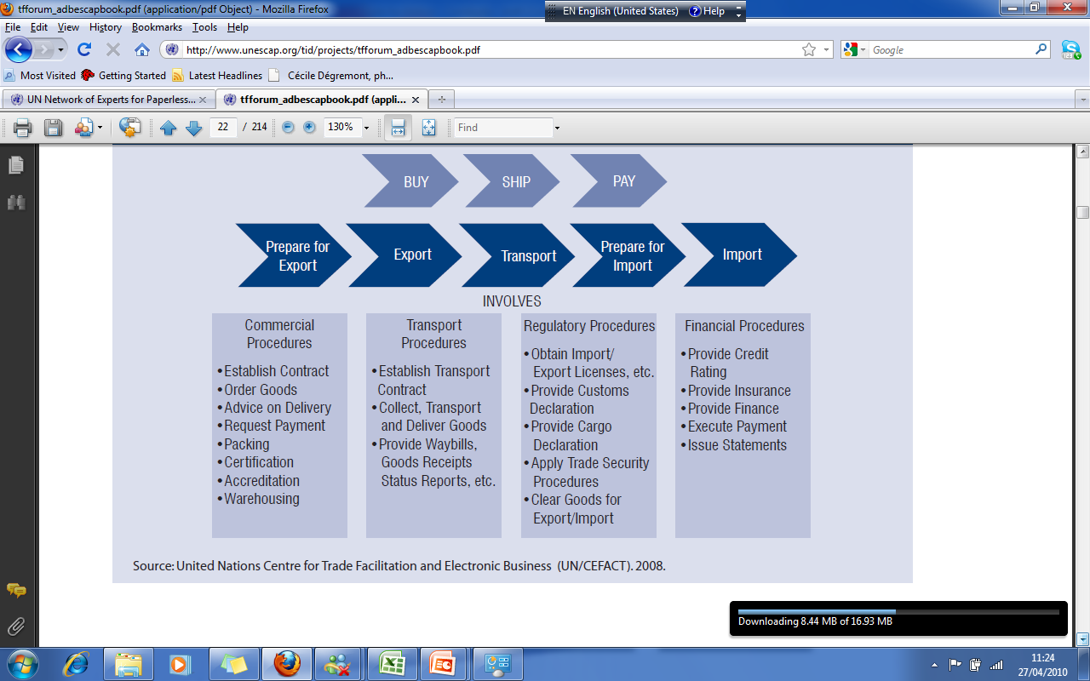
Trade procedures also apply to e-commerce

Slide 15
Overall implementation of trade facilitation measures in 44 Asia-Pacific economies surveyed
East and North-
East Asia (69.6%)ª
Australia and New Zealand (86.6%) ª
South-East Asia (56.1%) ª
South and South-West Asia (41.3%) ª
North and Central Asia (41.5%) ª
Pacific Islands Developing Economies (25.2%) ª

Slide 16
De Minimis Thresholds—Selected Asian Economies, as of April 2016

Slide 17




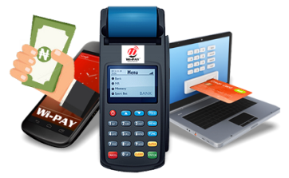
To unlock the potential of digital trade and e-commerce,
it is imperative to take on the following measures
Institute legal, regulatory and institutional reforms
Enhance affordability
of and access to ICT
Improve logistics and delivery infrastructure
Intensify regional efforts to modernize and harmonize regulations
Broaden the e-payment availability and options

Slide 18
Creating a Virtuous Cycle in E-marketplace Development
Government agencies and
trade associations
Create institution-based trust
Supplement government role
E-commerce vendors
and businesses
Create trust
  Characteristic-based trust
  Process-based trust
  Innovate
Social Willingness
to Participate in
The E-marketplace
Consumers
Engage in ethical and responsible actions
Source: ADB compilation based on Albers‐Miller (1999), Ang et al. (2001), Levi (1998), and Zucker (1986).

Slide 19

2030 agenda for sustainable development
E-commerce for inclusive development

Slide 20

Cross-border e-commerce for rural development and SMEs?
A subsidiary of Alibaba Group signed a purchase
deal for at least 800,000 durians from farmers’
cooperatives in three eastern provinces of Thailand
for sale in China in 2019.

Slide 21
A journey of a thousand miles begins with a single step
Partners: ADB, ESCAP, CAREC Institute, World Bank, UNCTAD, World Customs Organizations…
Work with regional e-commerce platforms to sell national products to overseas markets. Such cooperation will have spill over effects: the least developed countries may also learn the advanced knowledge on cross-border e-commerce; build their capacities in developing e-commerce; and identify more business opportunities.

Slide 22
A few questions in the context of CAREC
What are the drivers of e-commerce at the national level, and what kind of public-private partnerships can be leveraged to promote e-commerce in least developed countries and developing countries?
What critical regulatory and policy framework should be put in place to support developing and the least developed countries to build up their competitiveness in goods and services through e-commerce?
How can the work of donors and partners play a role in prioritizing the agenda for e-commerce development?
As data on the digital economy and electronic commerce underpin evidence-based policymaking, what are the solutions to collect such data.

Slide 23

Thank you!
http://www.unescap.org/
https://www.unescap.org/our-work/trade-investment-innovation
https://artnet.unescap.org/sti

