Slide 1

Country Performance on the CRII
Teresita Cruz del Rosario, PhD
Sernior Research Associate
Asia Research institute – National University of Singapore

Slide 3
COUNTRY SUB-GROUPINGS
High/Medium Integration
CWC ExPRC
AVERAGE 0.373 0.399
Kazakhstan 0.444 0.494
Kyrgyz Republic 0.408 0.446
PRC 0.434
Uzbekistan 0.361 0.427
Georgia 0.364 0.423
Tajikistan 0.369 0.419
Azerbaijan 0.400 0.410
Turkmenistan 0.400 0.400
Low Integration
CWC ExPRC
AVERAGE 0.373 0.399
Pakistan 0.344 0.349
Mongolia 0.373 0.332
Afghanistan 0.211 0.288

Slide 4
POLICY PROPOSALS: Low Integration Countries
Afghanistan: low scores: infrastructure and connectivity 0.291; FMI 0; Regional Value Chain 0.306
increase investments in Infrastructure and connectivity to connect to major markets;
support SMEs (constitutes 75% of economy)
Support Financial Development
Pakistan: medium scores: regional value chain 0.524; infrastructure and connectivity 0.417;
low score: trade and investment: 0.161
Enhance support for infrastructure to link to China and India (two economic powerhouses)
ADB support for Turkmenistan-Afghanistan-Pakistan-India (TAPI) natural gas pipeline for badly-needed energy resources
Support for the apparel sector; extend assistance to enhance regional value chains
Diversify export markets for apparel within the region
Mongolia: high scores: regional value chain 0.525; movement of people 0.500;
low scores: trade and investment 0.370; FMI 0.169; infrastructure and connectivity 0.388
diversify agricultural sector, competitive advantage in livestock/meat products
Strengthen regional value chains in agriculture
Promote tourism
Competitive advantage in renewable energy (wind , solar)

Slide 5
Medium Integration
Uzbekistan: high scores: regional value chain 0.507; infrastructure and connectivity: 0.409
low scores: trade and investment: 0.227; movement of people 0.185; FMI 0.126
develop agricultural RVCs in high value horticulture, livestock farming, diversify beyond cotton production
develop tourism industry to exploit country’s heritage sites
Infrastructure development and improvement to link Uzbekistan, Kazakhstan and Tajikistan along major CAREC corridors
Human capital investments to exploit the “demographic dividend”
Georgia: high scores: infrastructure and connectivity 0.772
low scores: trade and investment 0.154; RVC 0.283; movement of people 0.341
investment in Anaklia Deep Seaport and Special Economic Zone to further strengthen connectivity between CAREC region and Europe
Diversify export markets within the CAREC region for balanced trading relationships with EU
Support tourism development
Tajikistan: high scores: RVC 0.654; infrastructure and connectivity 0.522; movement of people 0.415
low scores: trade and investment; 0.133 FMI 0.054
Infrastructure investments in transport and energy, particularly the Dushanbe-Kyrgyz road network
Reconnection to the Central Asia Power Systems (CAPS)
Leverage abundant hydropower resources for intra-regional energy exchange
job creation skills to wean away dependence on remittances
Private sector development in support of SOE reform

Slide 6
Medium Integration (con’t)
Azerbaijan: high scores: movement of people 0.603; infrastructure and connectivity 0. 530; RVC 0.506
low scores: trade and investment ; 0.096 FMI 0.089
Explore synergies with Baku Port and Anaklia Deep seaport in Georgia, as maritime transport hub for CAREC region and beyond
Reduce dependence on extractive industries through support for agriculture; develop agricultural RVCs
Policy interventions in border management; data management of movement of people at entry/exit ; support for more efficient migration and asylum regimes;
Support legislative reform for movement of people
Diversify export markets to spur intra-regional trade
Turkeministan: high scores: RVC 0.606; Infrastructure and Connectivity 0.502;
low scores: Trade and Investment 0.047; FMI 0.045; Movement of People 0. 281
as world’s 12th supplier of natural gas, investments in regional exchange program to promote energy security; continuing support for TAP, TAPI, and TUTAP to streamline regional energy exchange
Diversification of economy beyond natural gas and cotton exports, supporting regional market development
Privatization of banks to increase private sector credit to GDP
Credit access to SMEs through private banks
Airport and railway construction to enhance infrastructure and connectivity

Slide 7
High Integration Countries
Kazakhstan: high scores: Infrastructure and Connectivity 0.551; RVC 0.545; FMI 0.381
low scores: trade and investment 0.164
Most integrated country in the region; high potential to increase intra-regional trade
Relatively high scores in FMI , potential to promote financial integration through the Astana International Financial Centre
Diversification of economy to reduce dependence on extractive industries
High level of education can be exploited for its potential for regional knowledge centers as knowledge hubs , in collaboration with the PRC
PRC: high scores: FMI 0.788; RVC 0.544; Infrastructure and Connectivity 0.480
low scores: Trade and Investment 0.006; movement of people 0.258
Interpret scores with caution. These are results for whole of China, not for XUAR and IMAR; need to disaggregate data analysis
Need to spur intra-regional trade and also focus Chinese investment to the CAREC region
Collaborate with Kazakhstan to promote knowledge hubs for regional integration
Invest in the development of intra-regional value chains especially in burgeoning manufacturing sectors in the CAREC region
Kyrgyz Republic: high scores: RVC 0.508; infrastructure and connectivity 0.420
low scores: trade and investment 0.380; FMI; 0.108
Competitive advantage in garment industry through SMEs; need to advance along regional value chain by expanding to regional markets beyond Kazakhstan; capacity building in branding, marketing, distribution, technological advances in garment production
Support development of agricultural RVCs
Infrastructure investments in hydropower; road network improvement on Dushanbe-Kyrgyz corridor

Slide 8
Growth Triangle Approach
ADB: “to solve the practical problems of regional integration among countries at different stages of economic development, even with different economic and social systems.”
Geographical Growth Triangles:
Brunei-Indonesia-Malaysia-Philippines East Asia Growth Area (BIMP-EAGA)
Greater Mekong Subregion (GMS): Cambodia, Laos, Myanmar, Thailand, Vietnam, Yunnan and Guanxi provinecs in China
Sectoral Growth Triangles:
Knowledge triangle
Transport and Logistics triangle
Energy Triangle
Financial Integration Triangle
Cross-border Tourism Triangle
Regional Value Chain Triangle (agriculture, horticulture, livestock, garments, etc.)

Slide 9
GREATER MEKONG SUBREGION

Slide 10
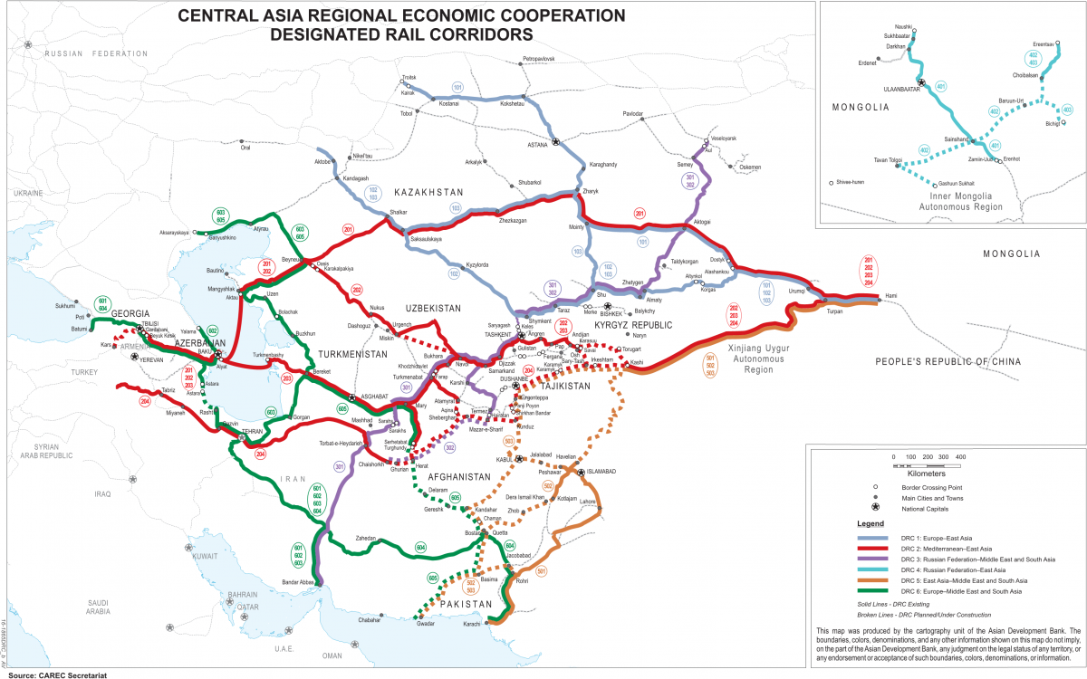

Slide 11

STRIKE:
Strengthening Regional Integration through
KNOWLEDGE ENHANCEMENT

Slide 12
FIVE AREAS of KNOWLEDGE COLLABORATION
ENERGY TRADE
TOURISM
AGRICULTURAL REGIONAL VALUE CHAINS
PROMOTING GOOD BUSINESS /INVESTMENT CLIMATE
COOPERATIVE WATER GOVERNANCE

